Slide 1



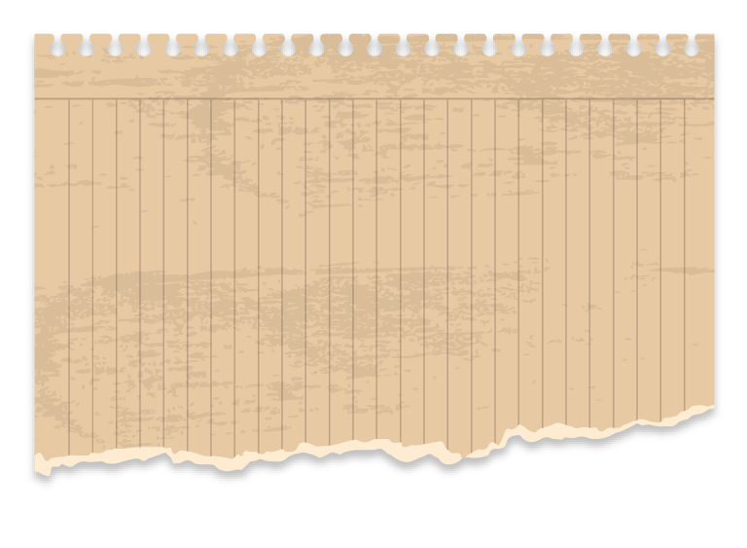
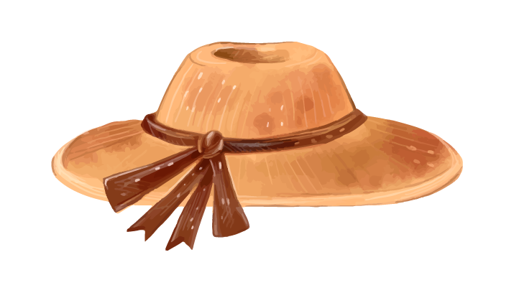

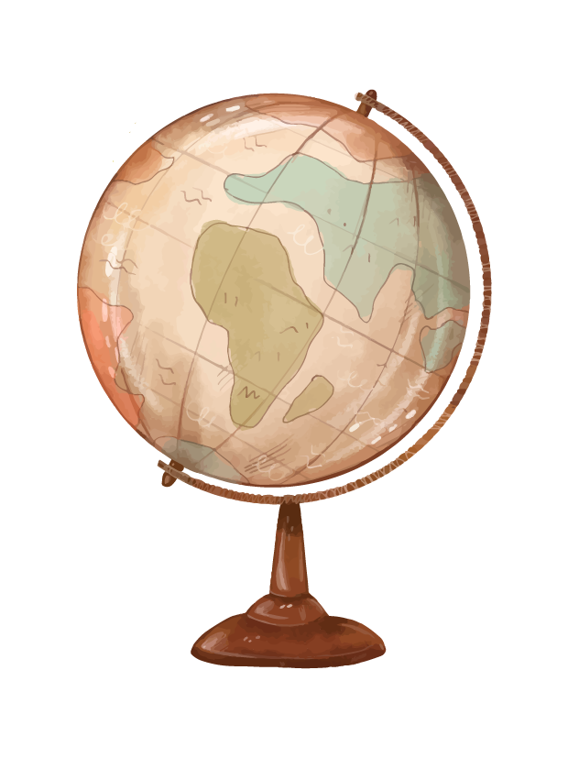
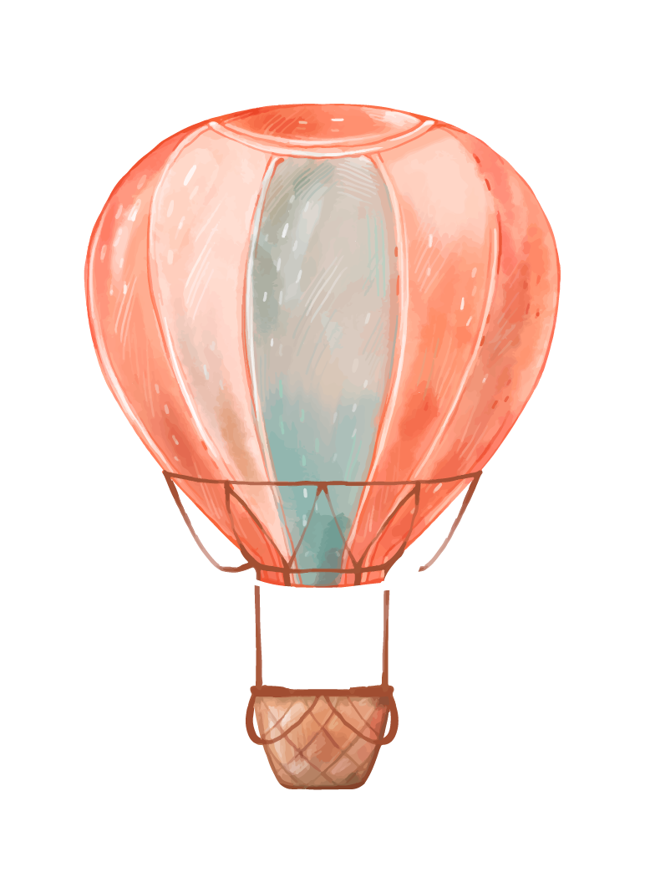

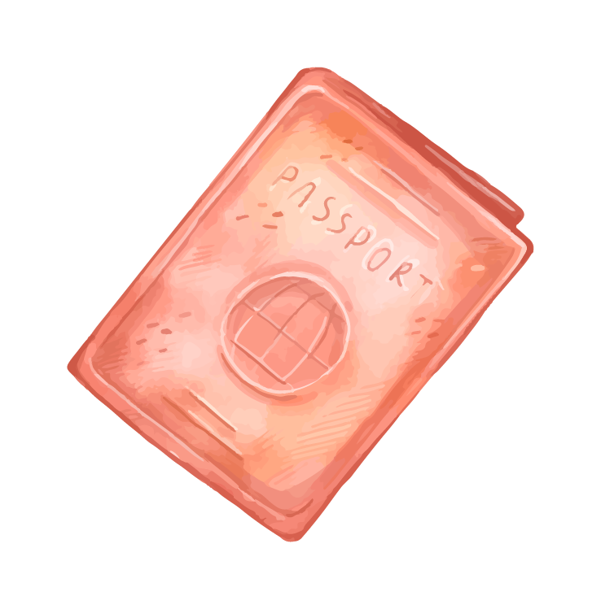



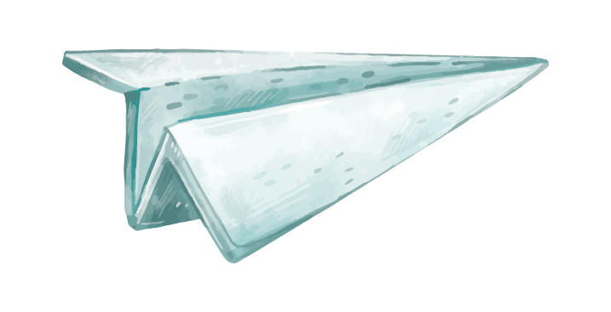



PowerPoint Animation presents…

Slide 2
Michael Smith

Slide 3


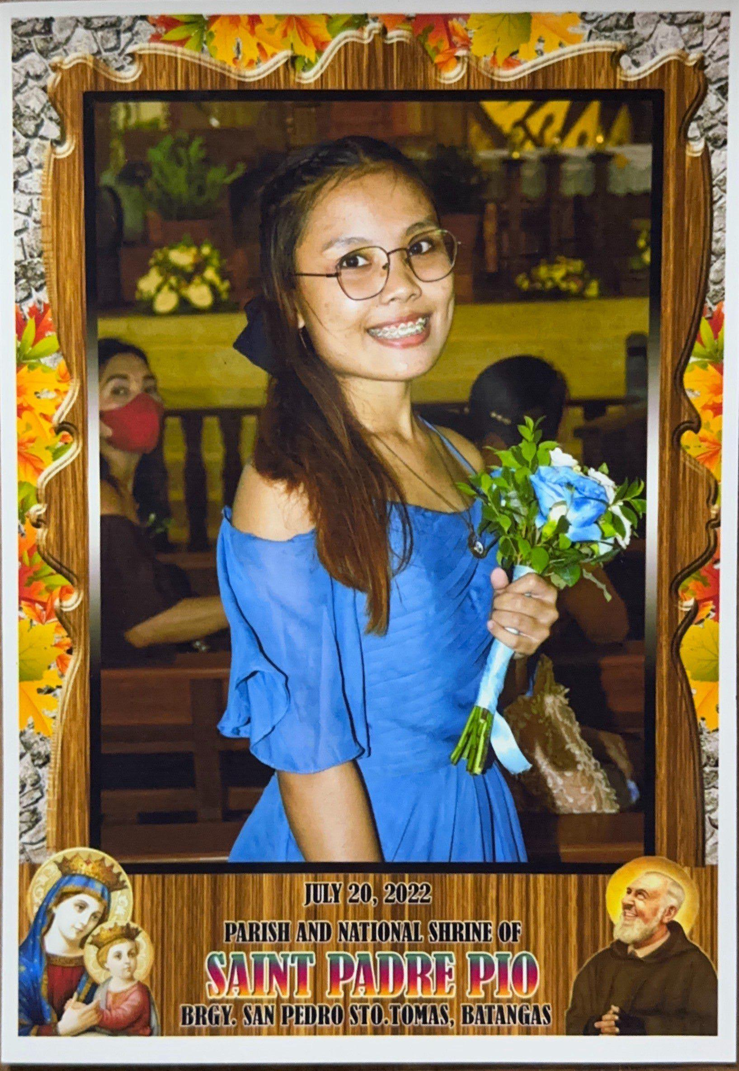
She is 22 years old
born on the 10th of July in the year 2001.
Her friends that she met online calls her “Blue”. Her coworkers call her “betbet”.

Slide 4

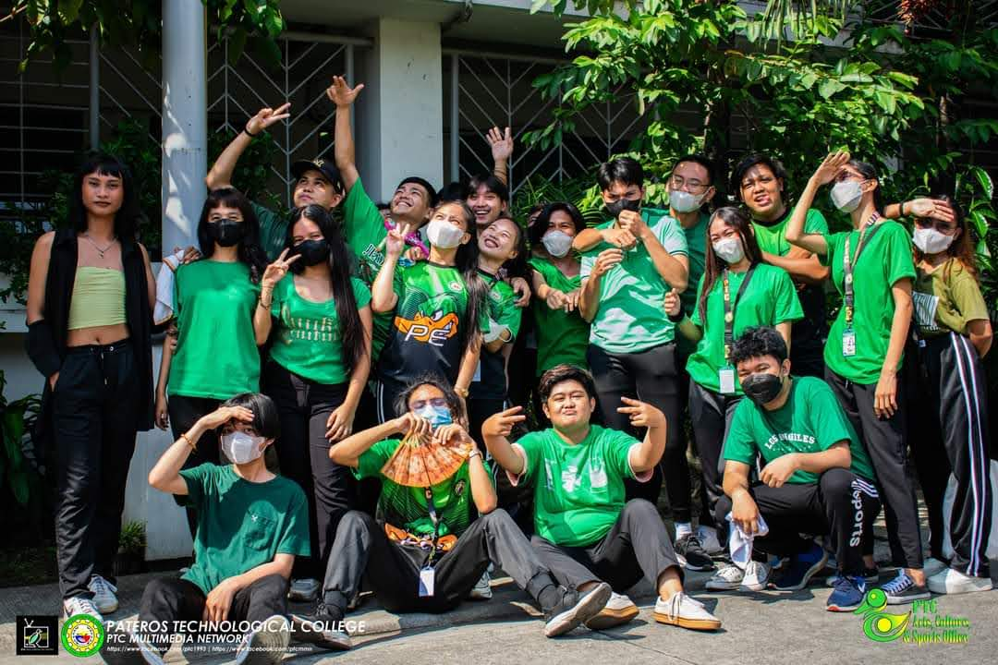
Born and raised in the city of San Pedro, Province of Laguna.
She is a second-year Pateros Technological College student seeking a Certificate in Computer Science.

Slide 5

Born and raised in the city of San Pedro, Province of Laguna.
She is a second-year Pateros Technological College student seeking a Certificate in Computer Science.

Slide 6


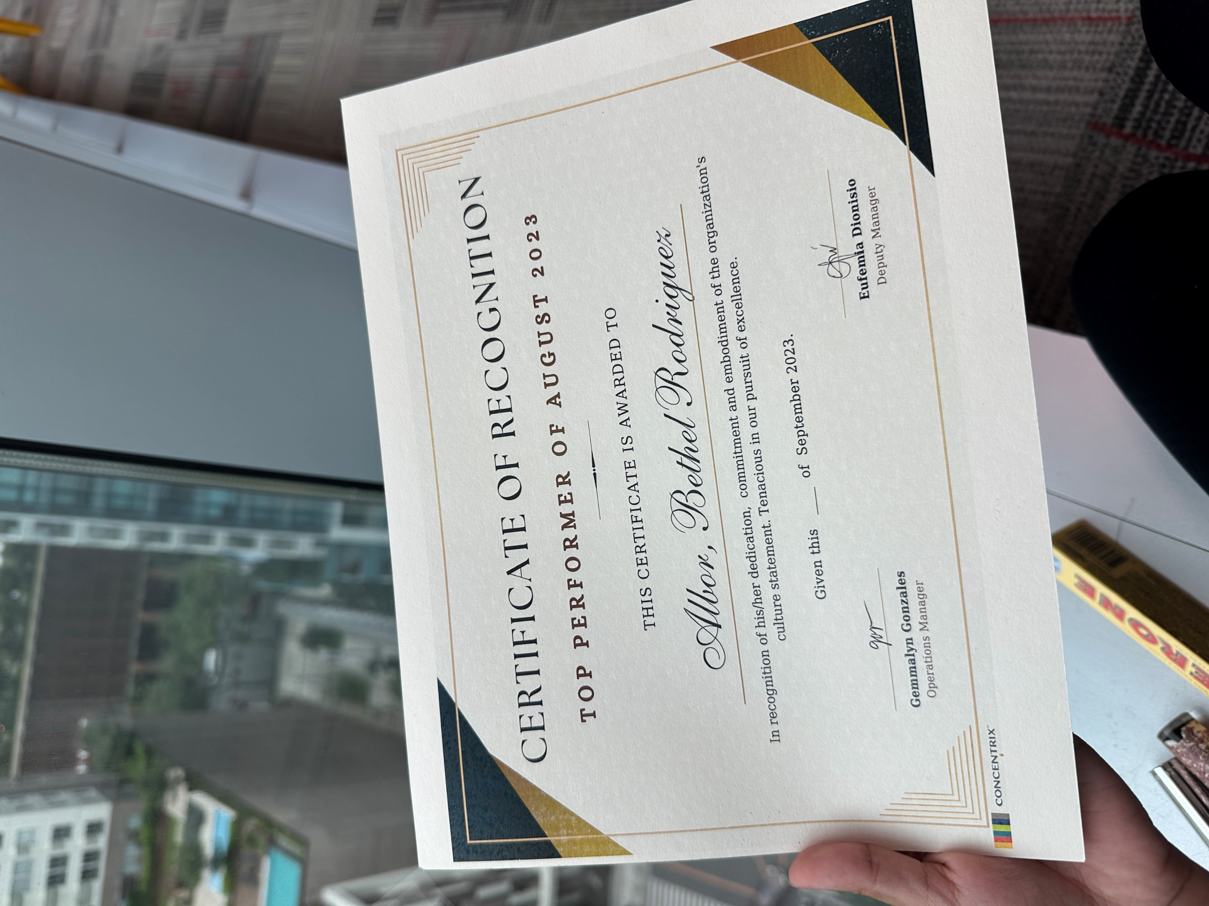
She also works as a Technical Support agent for Google in Uptown BGC.
She is a second-year Pateros Technological College student seeking a Certificate in Computer Science.

Slide 7

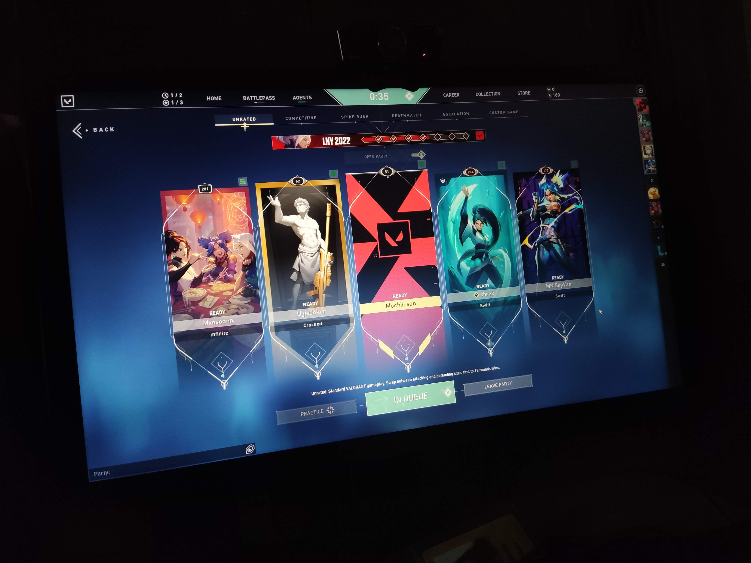
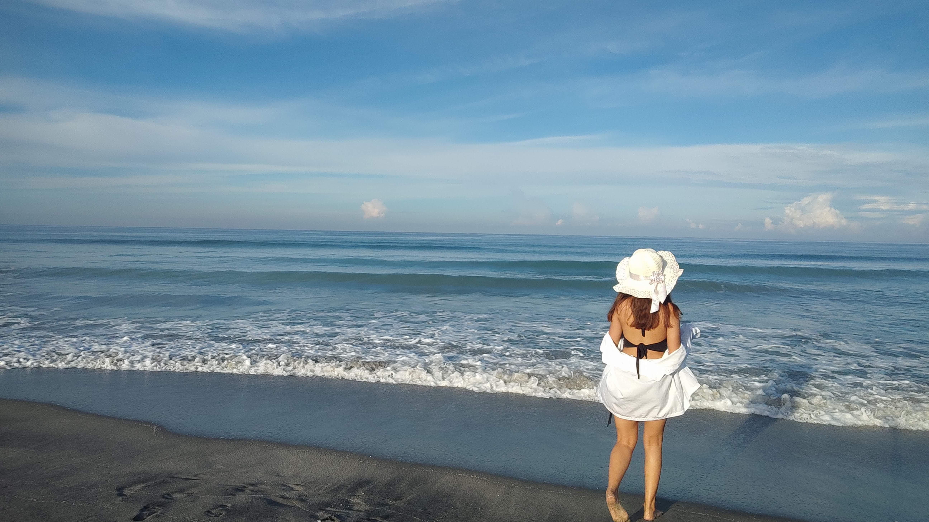
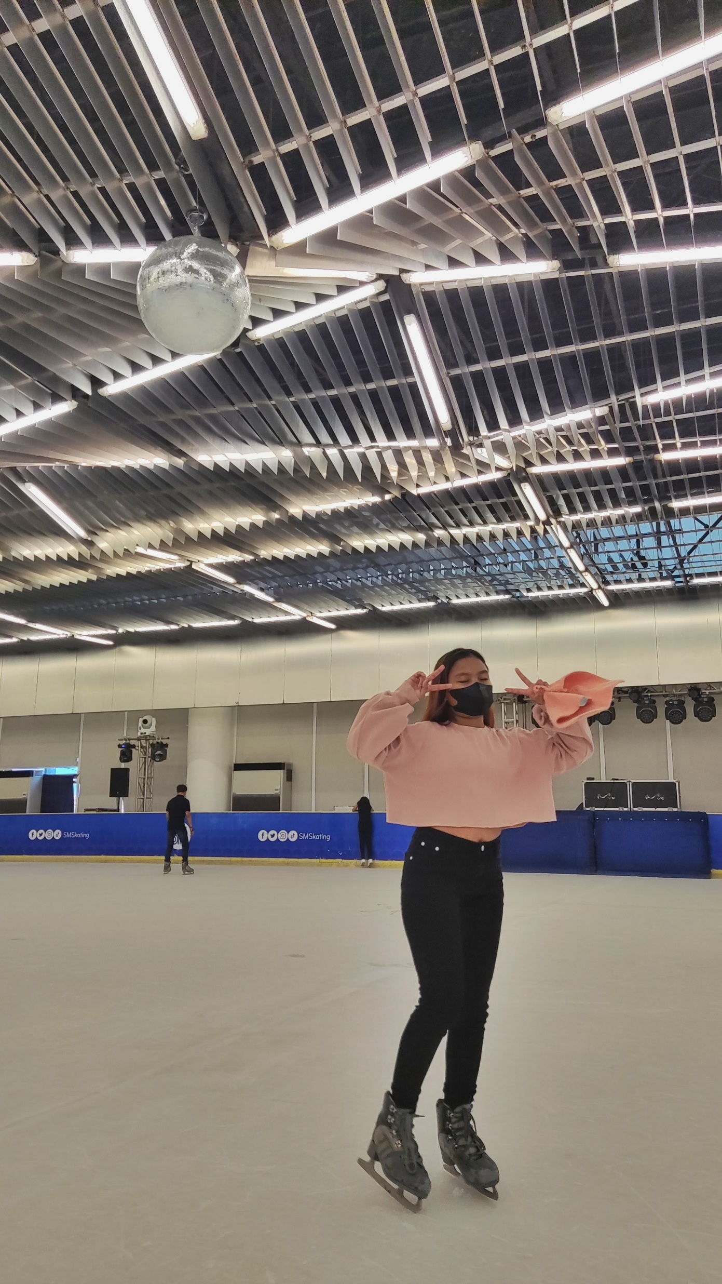
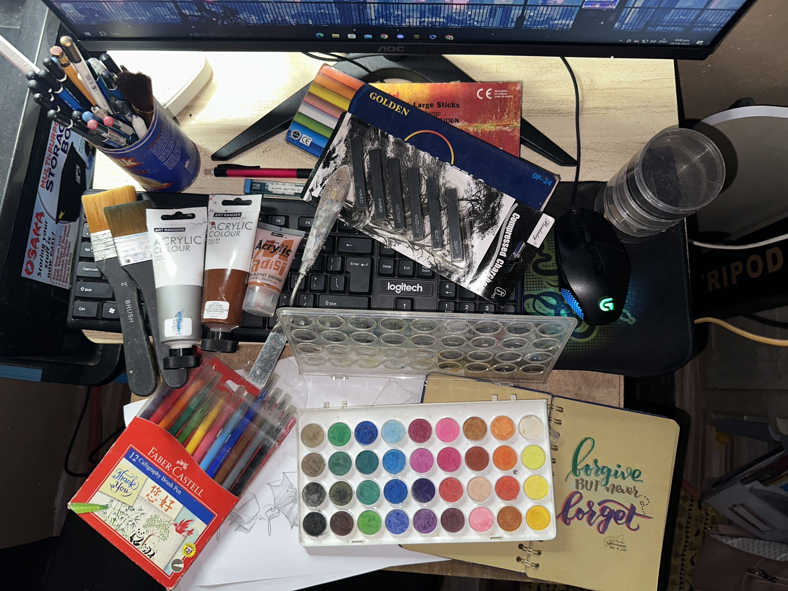

Slide 8
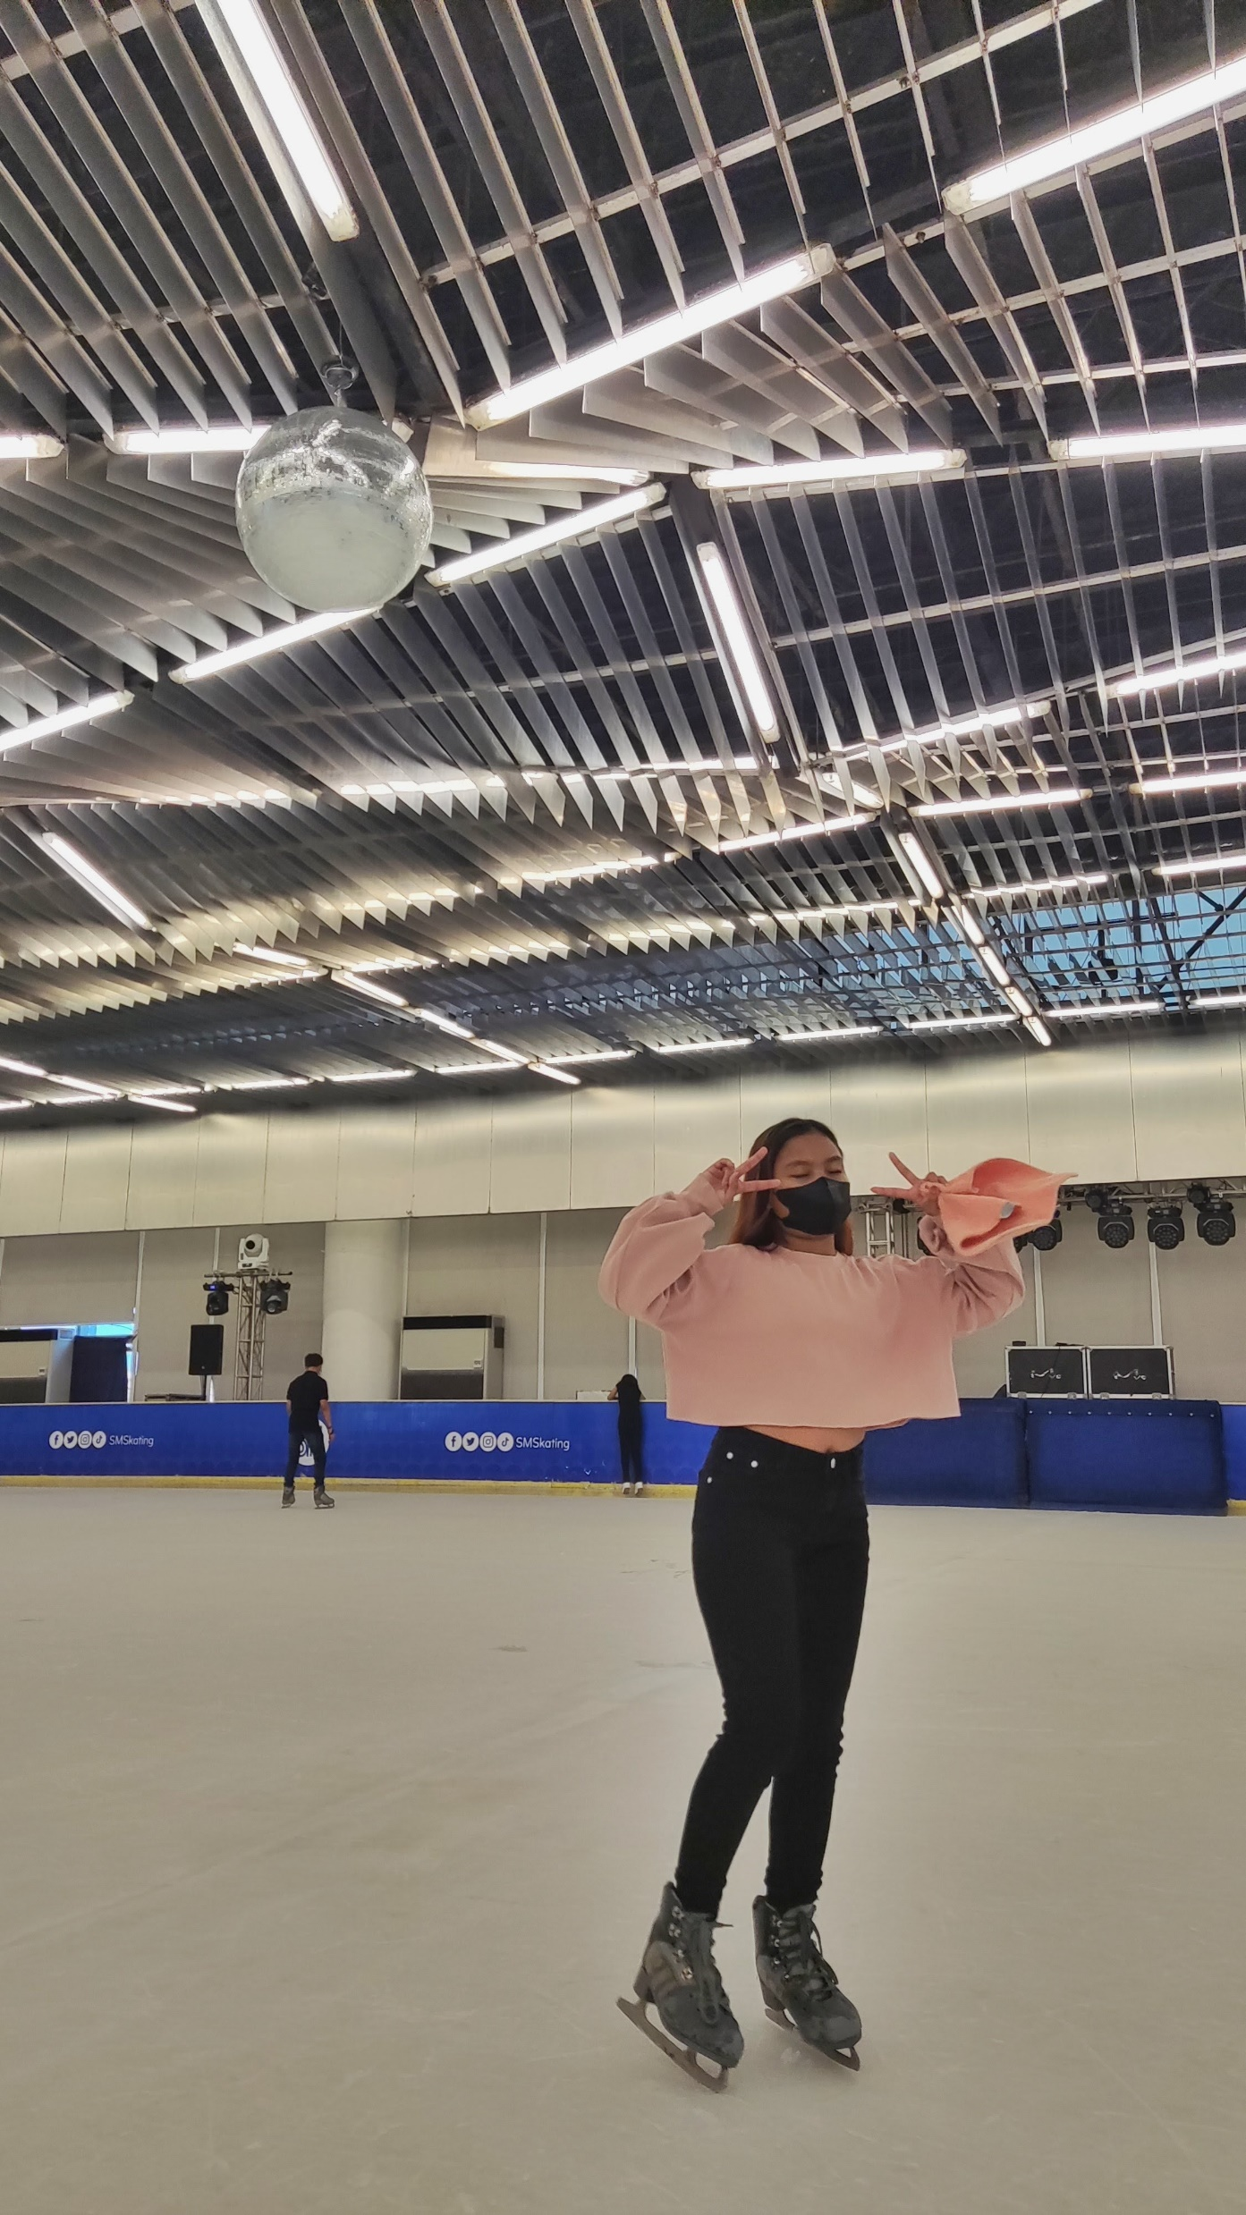
Bethel enjoys doing art, going to beaches,ice skating, and playing video games which she finds difficult to achieve nowadays due to her tight schedule.

Slide 9
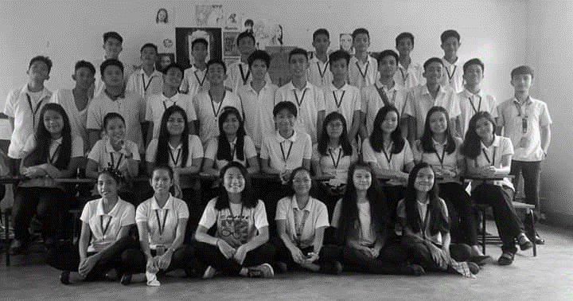
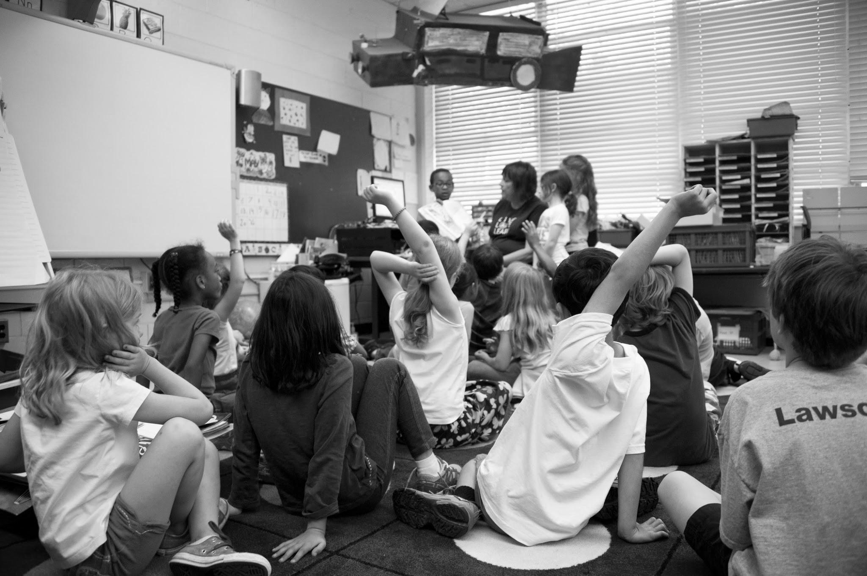
BREAKING NEWS
SAD NEWS
SAD NEWS
2 4 t h . E D I T I O N
OCTOBER 13, 2023
PAUSED HER EDUCATION!
GET TO KNOW BETHEL ALBOR!
BIG NEWS
Bethel plans to continue studying while working after graduation, hopefully next year, to earn a bachelor's degree in Information
Bethel had an ambition of becoming an architect, which she pursued in high school, but given that her family’s financial situation, she needed to find work after graduating in high school to support her family.
technology and become the family's first degree holder.

Slide 10
Office Productivity 2 (Animation) Activity 2
POWERPOINT ANIMATION
Created by Bethel Albor
CCS 2G
Submitted on October 14, 2023
All rights reserved ©
THAT’S ALL

